Slide 1
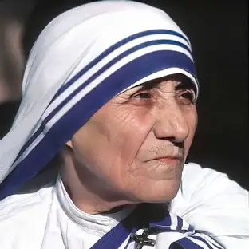
Mother Teresa
Mary Teresa Bojaxhiu MC, better known as Mother Teresa or Saint Mother Teresa, was an Albanian-Indian Catholic nun, founder of the Missionaries of Charity and is a Catholic saint. Born in Skopje, then part of the Ottoman Empire, she was raised in a devoutly Catholic family.

Slide 2
Mother Teresa Biographical
Mother Teresa was born Agnes Gonxha Bojaxhiu in Uskup, Ottoman Empire (now Skopje, North Macedonia), on August 26, 1910. Her family was of Albanian descent. At the age of twelve, she felt strongly the call of God. She knew she had to be a missionary to spread the love of Christ. At the age of eighteen she left her parental home in Skopje and joined the Sisters of Loreto, an Irish community of nuns with missions in India.

Slide 3
At the height of the Siege of Beirut in 1982, Mother Teresa rescued 37 children trapped in a front-line hospital by brokering a temporary cease-fire between the Israeli army and Palestinian guerrillas. Accompanied by Red Cross workers, she travelled through the war zone to the hospital to evacuate the young patients.
Mother Teresa save 37 children

Slide 4
Her Family
Her family was of Albanian descent. At the age of twelve, she felt strongly the call of God. She knew she had to be a missionary to spread the love of Christ. At the age of eighteen she left her parental home in Skopje and joined the Sisters of Loreto, an Irish community of nuns with missions in India.

